Slide 1
Module 1:
Introduction to ECG & Normal ECG

Slide 2
Importance of Correct anatomical positions
Measurements & Morphologies ONLY accurate if
  Precise anatomical positions adhered to
  Standardised techniques are used

Slide 3
ECG Equipment Settings
Frequency Response
  0.05Hz – 150Hz
  companies often set these at 0.5 Hz – 50HZ
  These are filtered ECGs and can alter isoelectric line placement & morphologies
Gain sensitivity – calibration accuracy
  5, 10, 20mm/mV (standard 10mm/mV)
Chart paper speed
  25mm.sec – standard
  50mm/sec
(AHA 2007)

Slide 4
Precordial (Chest ) leads
Variations in precordial lead placement DIAGNOSTICALLY affects the ECG
Studies have shown V1& V2 are consistently placed TOO HIGH
Correct anatomical positions should be used
Deviations must be annotated on ECG
SCST (2010)

Slide 5
Chest lead placement
V1- 4th intercostal space at right sternal edge
V2 – 4th intercostal space left sternal edge (not always dead opposite V1)
V3 – midway diagonally between V2 & V4
V4 Fifth intercostal space mid-clavicular line. (Not under nipple, remember ribs curve around the chest)
V5 – Left anterior axillary line at same horizontal plane as V4- ( lay the arm straight down the side, the electrode goes in the crease in a line with V4)
V6-mid-axillary line in a horizontal plane with V5 (line form the middle of
Modified from SCST (2010)
middle of the arm-pit in a straight line with V5)
Modified from SCST (2010)

Slide 6
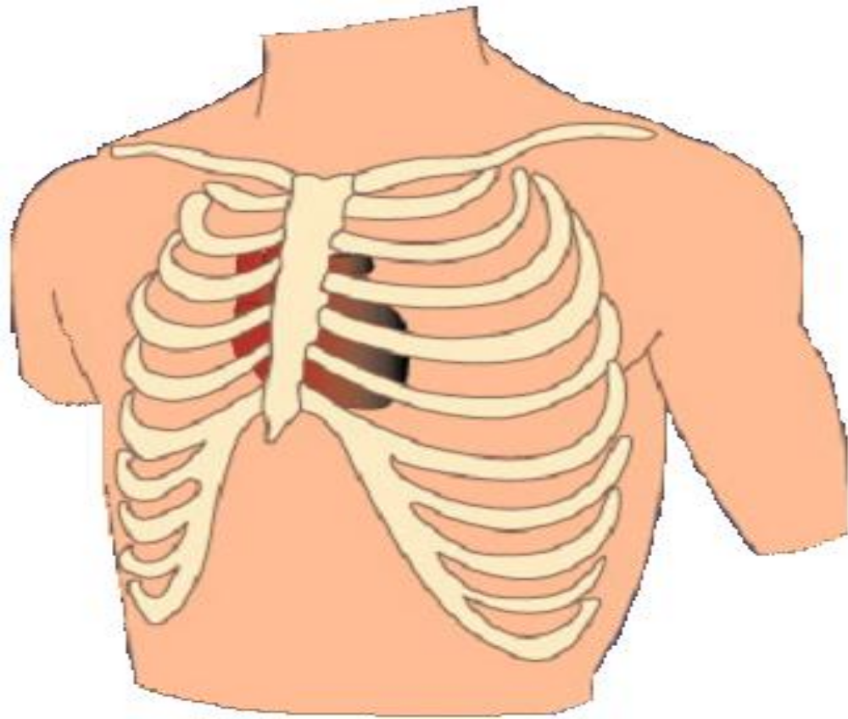
STANDARD LEADS
V1
V2
V3
V4
V5
V6

Slide 7
Quick Guide
Measure from sternal notch NOT clavicle
V4 mid clavicular NOT necessarily under the nipple
V4 under breast tissue NOT above
V4-V6 placed horizontally NOT curving up following rib cage

Slide 8
What should a Normal ECG look like?
Positive in lead 1
Negative in aVR
Increase in R wave progression V1- V5 (V6 can be a little smaller)
1 P wave for each QRS
Normal morphologies
Normal intervals

Slide 9
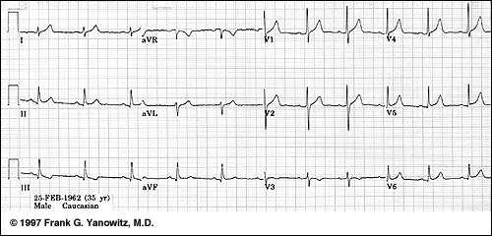
Transposition of V1 and V3
Poor R wave Progression (note V3)

Slide 10
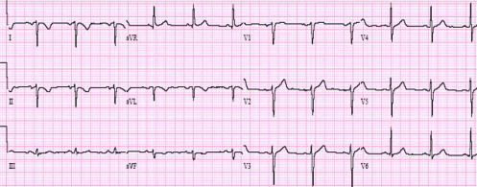
Technical Dextrocardia
Right and left arm transposed
(if not consider true dextrocardia)

Slide 11
References
Useful reading / guidelines
Crawford J & Doherty L ; Practical Aspects of ECG Recording: M&K publishing 2012
Society of Cardiological Science & Technology and the British Cardiovascular Society. (2010) Clinical Guidelines by consensus: Recording a standard 12-lead ECG an approved methodology. Available at http://www.scst.org/resources/consensus_guideline_for_recording_a_12_lead_ECG_Rev_072010bpdf

Slide 12
Normal ECG

Slide 13
ECG Paper
10mm = 1mV
5mm = 0.2secs
1mm = 0.04secs
When paper speed = 25mm/sec

Slide 14
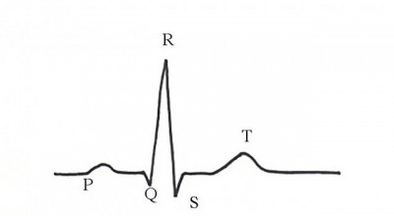
Intervals
PR interval – Beginning of P wave to beginning of QRS complex (0.12 -0.2 secs)
QRS complex - < 0.12 secs
ST segments - isolelectric line
QT interval –
QTc = QT interval
√RR interval
Where QT & RR are measured in time (secs )
(< .44secs)

Slide 15
Normal Heart rates
Fetus – varies from 120-160 bpm
Neonate – 70bpm when sleeping, upto approx 180bpm when active
Week old baby at rest – 140bpm
Year old – 120bpm
By 6 years old – average rate of <100bpm
Adolescent – 80bpm
Normal adult – 60-100bpm
The wide range of normal for an adult depends on fitness, emotional stress , physical activity etc.

Slide 16
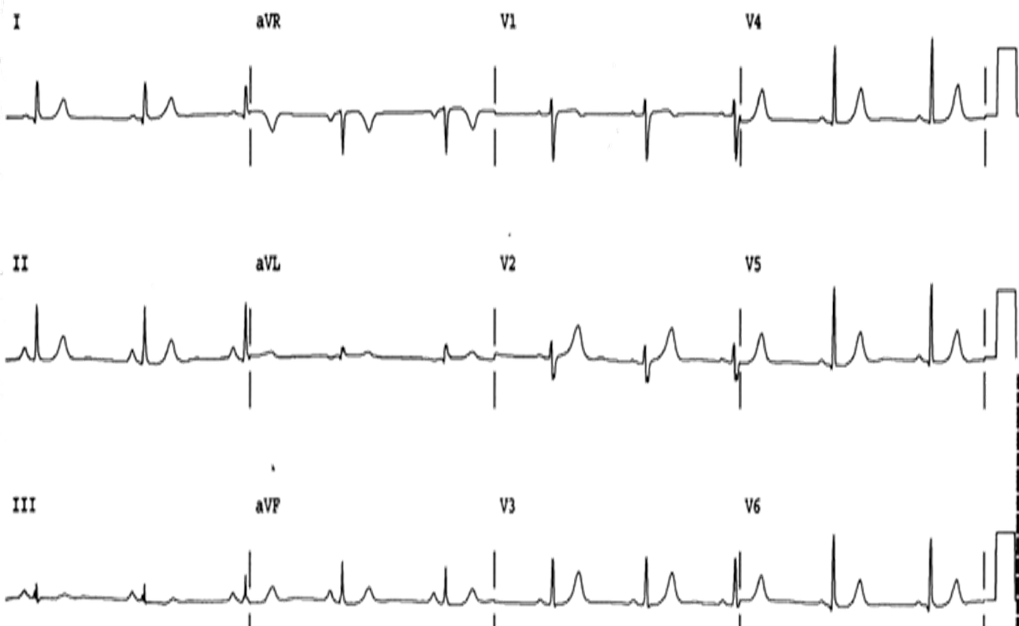
Sinus rhythm, no abnormalities
Against which all other ECGs can be measured
ECG interpretation process
Is there a clear definable P wave? YES
Is there 1 QRS for every P wave ? YES
Is it regular or irregular ? Could be both (sinus arrhythmia)
Intervals ? NORMAL
Morphologies?NORMAL

Slide 17
Module 2
ATRIAL FIBRILLATION

Slide 18
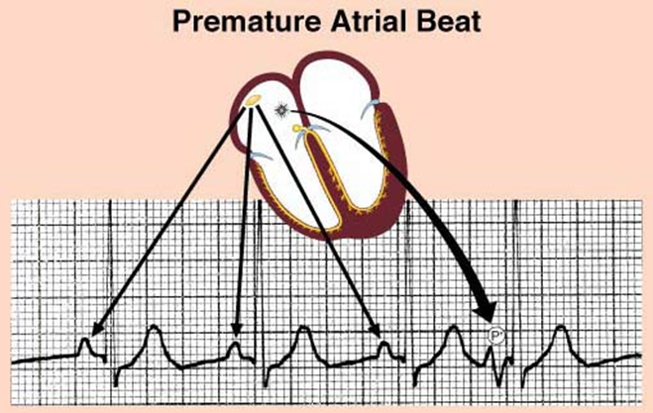
Atrial ectopic beat
Premature Normal
SVE
Premature
    Occurs in diastolic period of preceding sinus beat
    Seen earlier than the next expected sinus beat
Bizarre
    Origin of ectopic is a focus other than the SAN
    P wave will have different morphology
    May be notched, or inverted

Slide 19
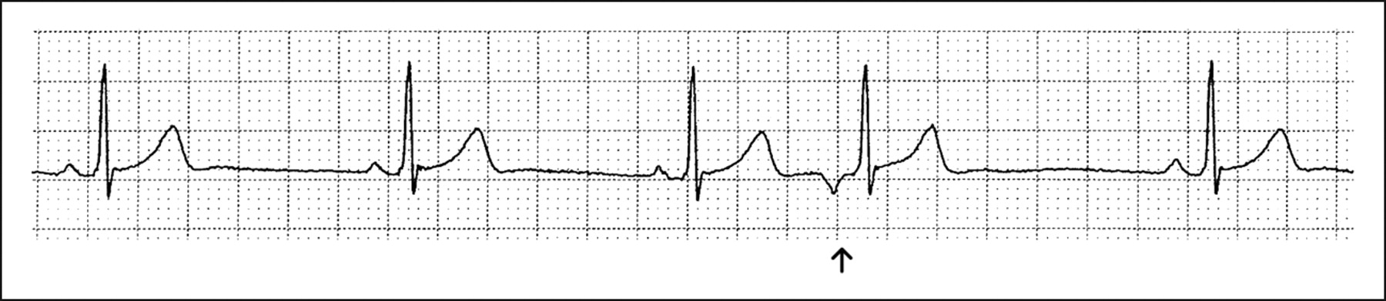
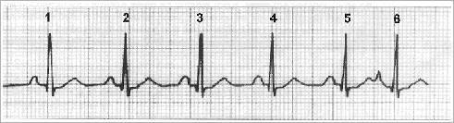
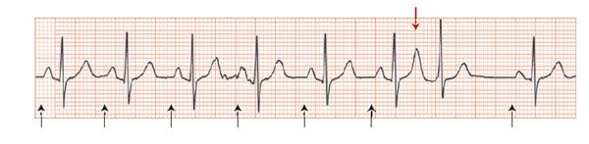

P wave morphology different morphology to sinus P wave
(maybe very subtle)
Inverted P wave
Peaked P wave
P wave in T wave

Slide 20
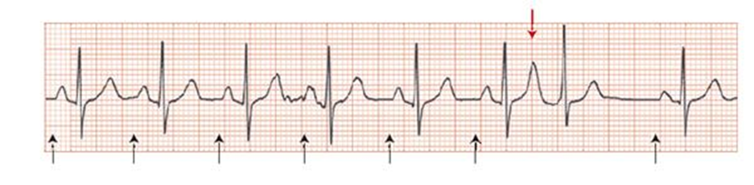
Compensatory Pause
Sinus rhythm has been disturbed
Compensatory pause following ectopic beat
Early beat , causes heart to go through a complete recovery phase before SAN can discharge again.
Sinus RR interval
Compensatory Pause RR interval

Slide 21
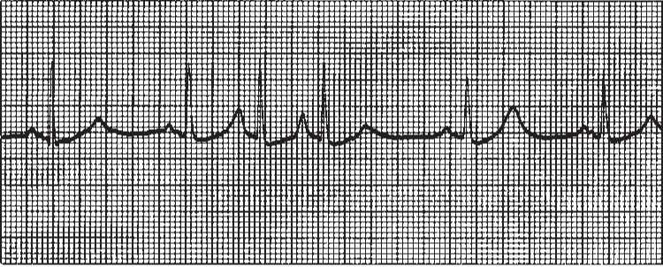
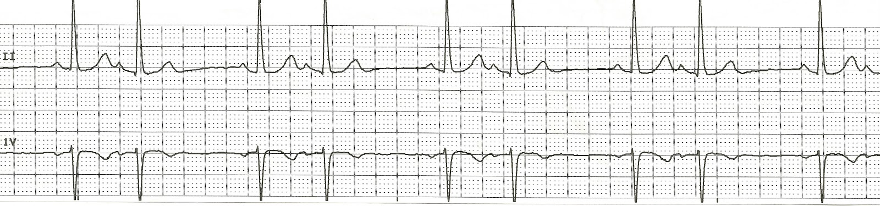
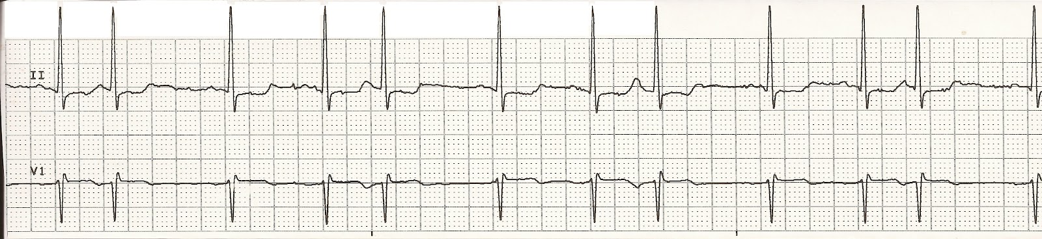
Multiple atrial ectopics
Atrial couplet
Couplet – 2 consecutive premature beats
Triplet - 3 consecutive premature beats
Salvo – more than 3 consecutive atrial ectopics
Atrial bigeminy – 1 normal beat followed by premature beat followed by normal beat
Atrial trigeminy – premature normal beat followed by 2 normal beats followed by premature normal beat
Sinus Rhythm with Atrial bigeminy
Sinus Rhythm with Atrial trigeminy

Slide 22
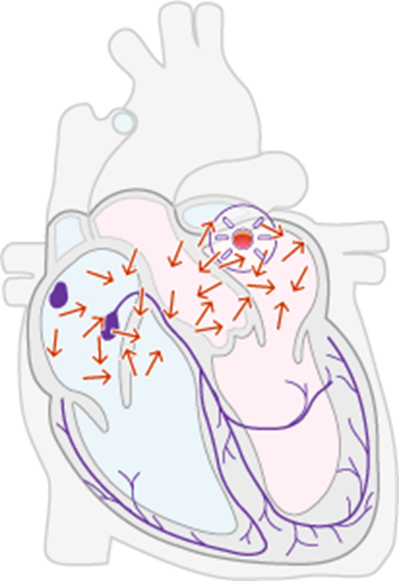
Atrial fibrillation
Uncontrolled, chaotic atrial rhythm
Disorganised excitation & recovery of atrial muscle
Impulse reached AVN at frequent yet irregular intervals- some are stronger than others
AVN can only conduct some of these impulses due to the refractory period
Pulses reaching the AVN during the refractory period are blocked
Respiration, emotion, vagal stimulation & exercise can vary the refractory period
Transmission to ventricles is irregular
Only signals LARGE enough and hitting the AVN post refractory will be conducted
Hence IRREGULAR rhythm

Slide 23
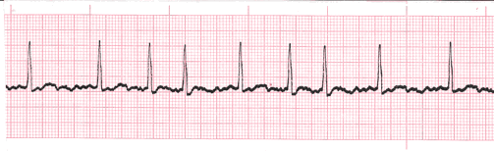
Atrial fibrillation
ECG Criteria
P wave – absent
  Small, rapid irregular fibrillation waves (can look like muscle tension)
Rhythm – irregular
QRS – normal duration (unless inter- ventricular conduction delay)
Rate – can be fast or slow or both - depending on AVN conduction

Slide 24
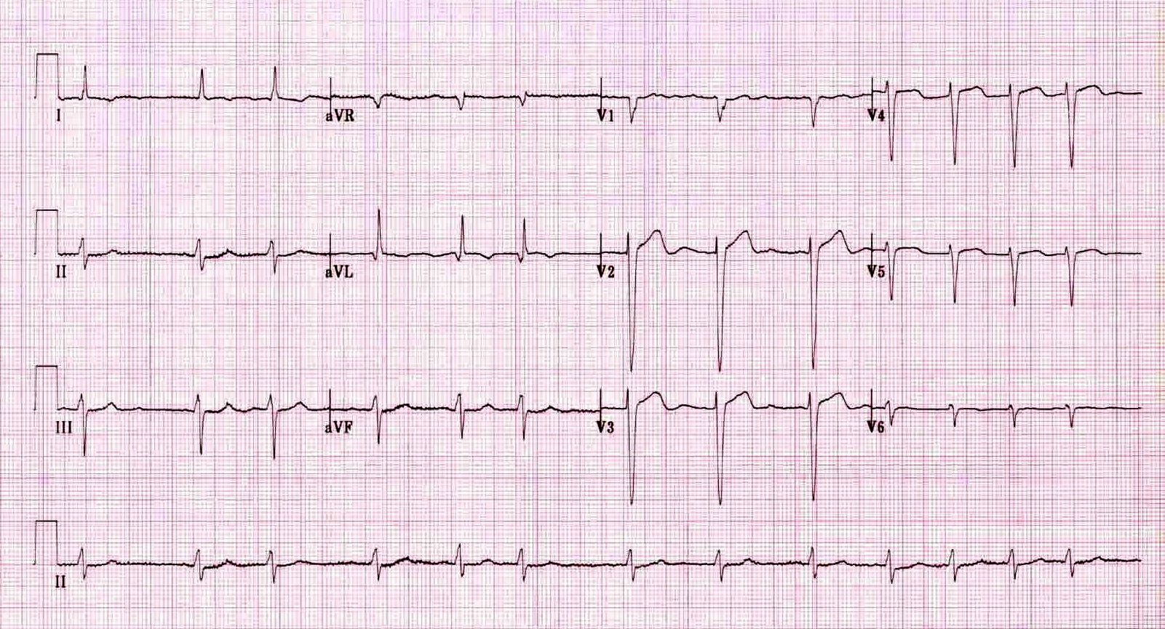
Fine AF
ECG Rhythm interpretation process
Is there a clear definable P wave? NO
Is there 1 QRS for every P wave ? N/A (no P waves)
Is it regular or irregular ? IRREGULAR
Intervals ?
No PR interval
NORMAL (QRS)
5. Morphologies?
NORMAL
Fine fibrillation waves
Irregular RR interval

Slide 25
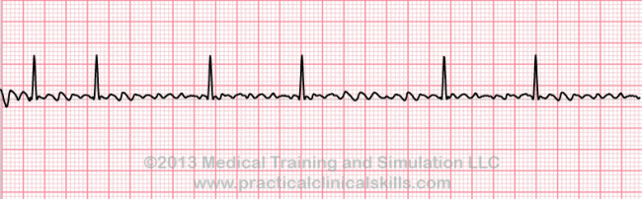
Course Atrial fibrillation
Course fibrillations waves
Often confused with Atrial flutter
No clear “saw-tooth “pattern
Irregular RR interval

Slide 26
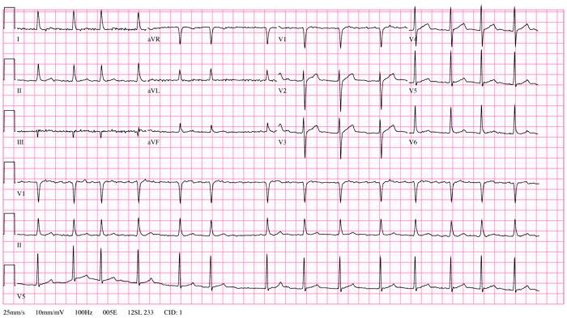
Atrial fibrillation with Rapid Ventricular response
AF with Heart Rate 100-150 bpm

Slide 27
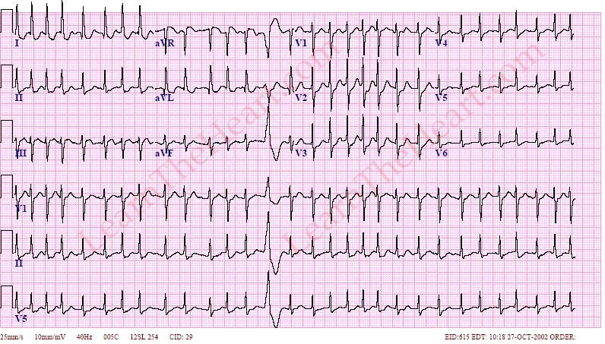
Fast Atrial fibrillation
No P clear definable consistent P wave
Irregular RR interval
HR > 150bpm

Slide 28
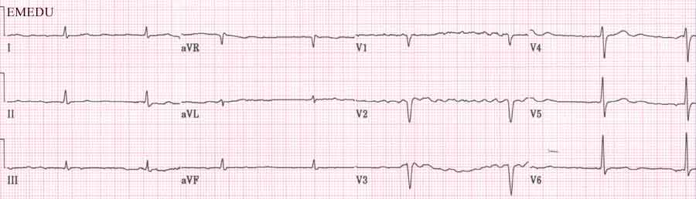
Atrial fibrillation with slow ventricular response

Slide 29
Module 3
Atrial flutter

Slide 30
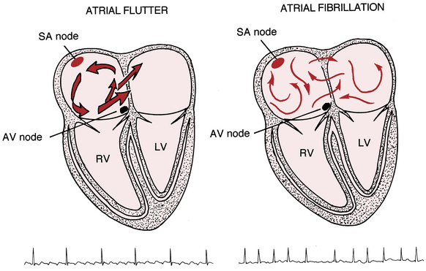
Rapid atrial conduction
Circus movement
  Continuous self-perpetuating circular path of excitation around orifices of SVC & IVC
Focal movement
  Ectopic focus in the atrium discharging rapidly
  AVN cannot conduct every impulse

Slide 31
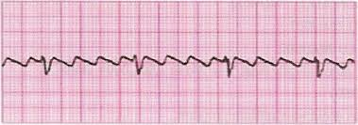
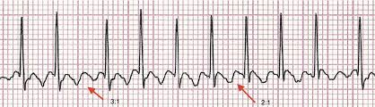
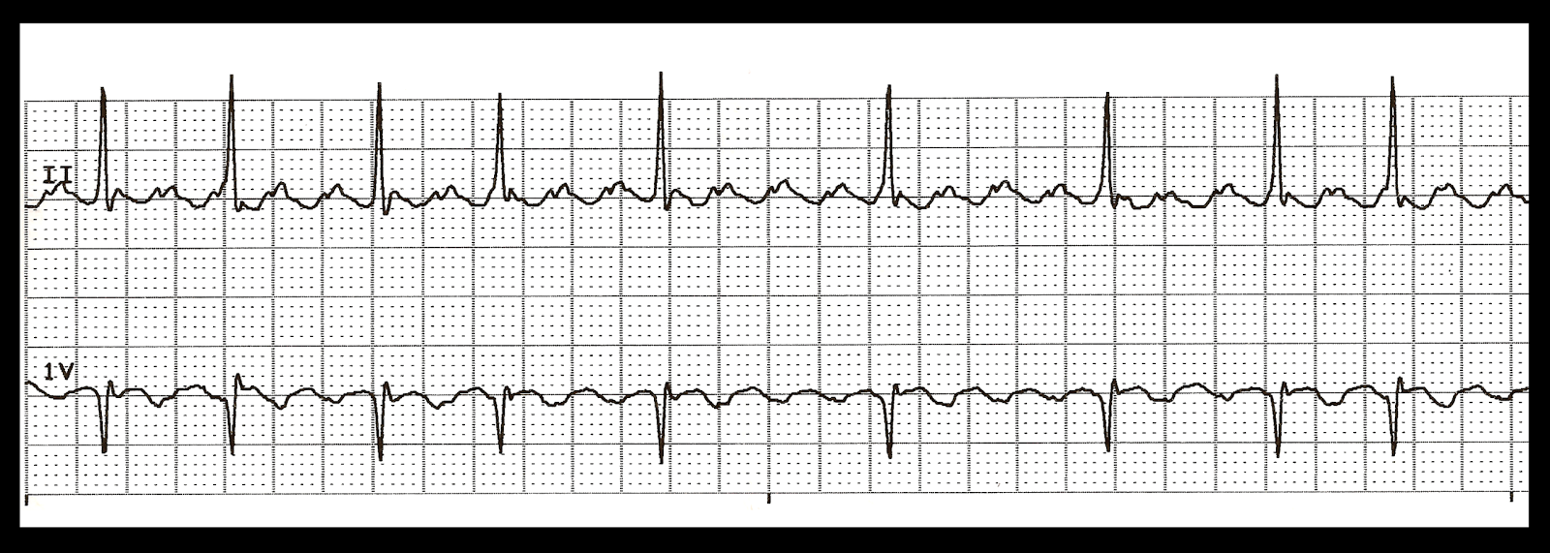
Saw – tooth Flutter Waves
3:1 block
2:1block
variable block
P wave – Rapid (300-350bpm) , bizarre but regular seen in a pattern
Ventricular Rhythm – more likely regular due to AVN conduction ability. But can have variable block
QRS – normal (without any IVCD)

Slide 32
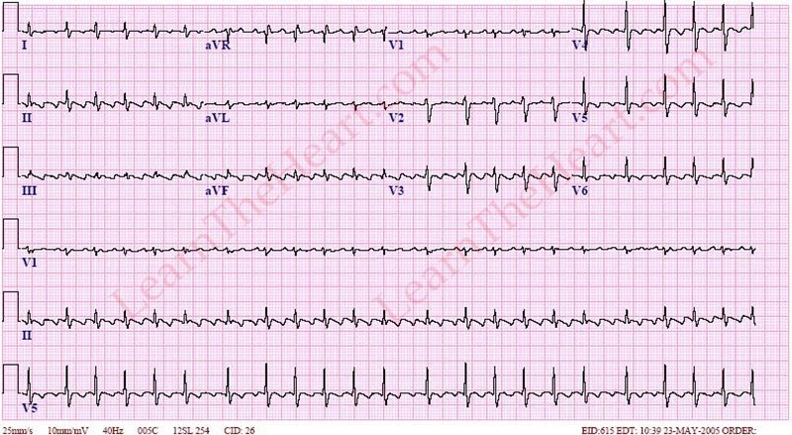
Atrial flutter – variable block
No clear definable P waves
“saw-tooth “ flutter waves
RR mostly regular with occasional variation

Slide 33
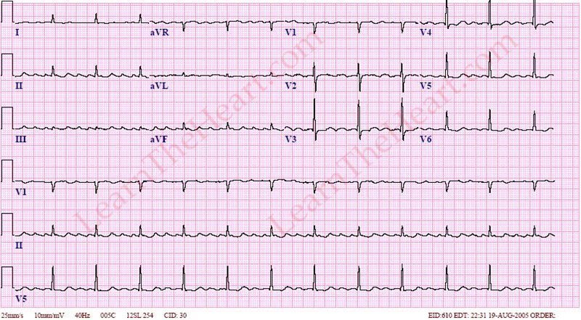
Atrial flutter 3:1 block
No clear definable P waves
“saw-tooth “ flutter waves
3 flutter waves to 1 QRS
RR mostly regular with occasional variation
Flutter Waves

Slide 34
Module 4:
Supraventricular Tachycardia
SVT

Slide 35
SVT
Narrow complex tachycardia
Focus above ventricles
Cycle can be shorter than refractory period
Some atrial impulses are blocked (normally 2:1 or 3:1)
Going so fast (>150bpm) P waves cannot be identified

Slide 36
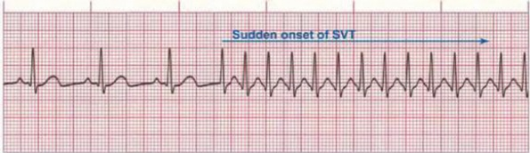
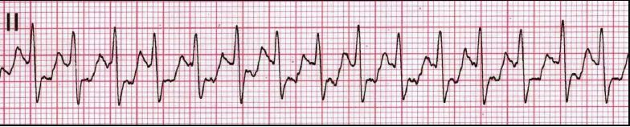
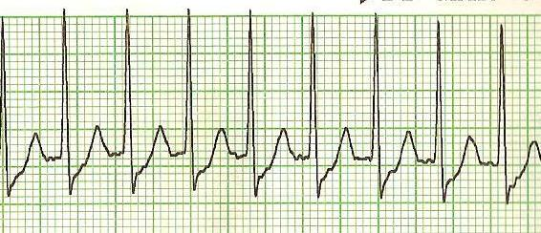
Sudden onset / Sudden offset
Non visible P waves
Regular RR interval
Narrow QRS
>150BPM
Often due to accessory pathway
May cause rate related Ischaemia

Slide 37
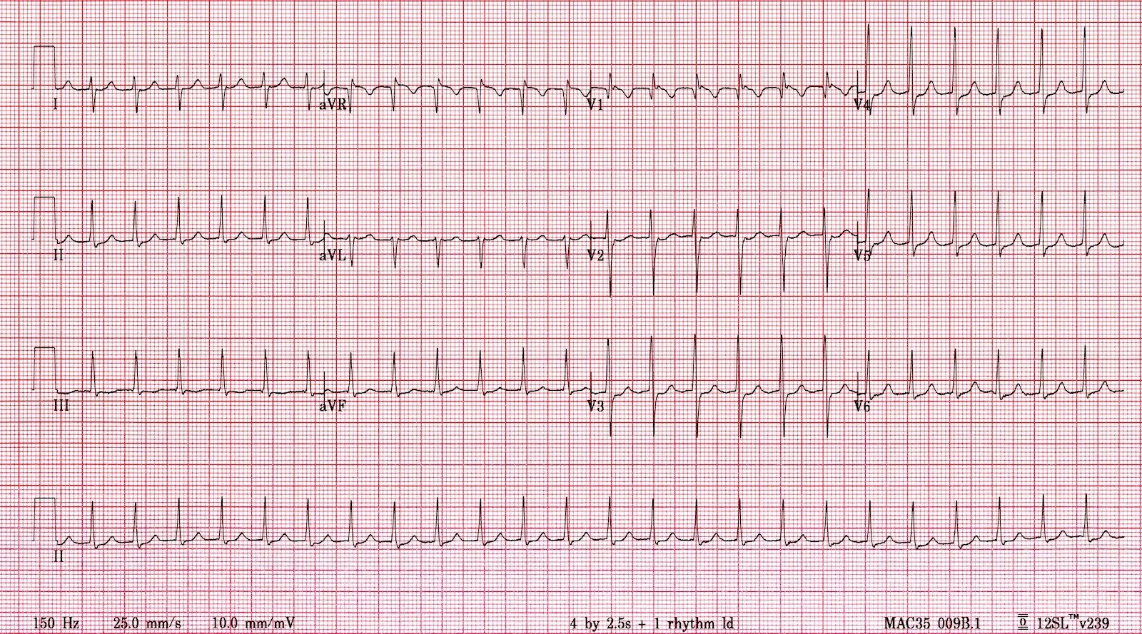
No P waves visible
QRS normal / narrow
RR regular
HR 150BPM

Slide 38
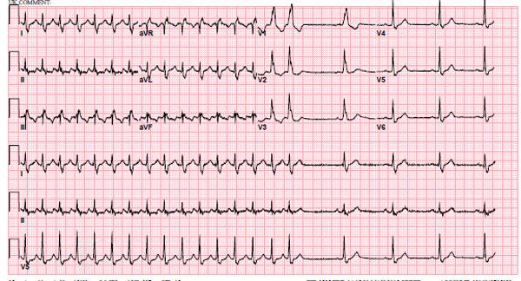
Initial ECG (SVT)
No P waves visible
QRS normal / narrow
RR regular
HR 150BPM
Post SVT
Sudden offset
1 P wave to 1 QRS
RR regular
Sinus rhythm
SVT returning to Sinus rhythm

Slide 39
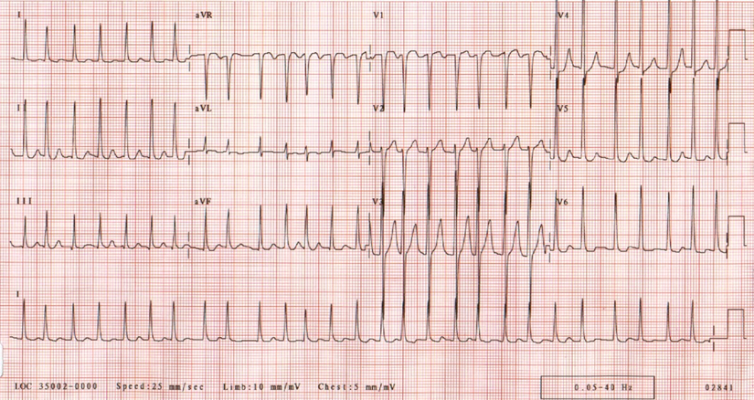
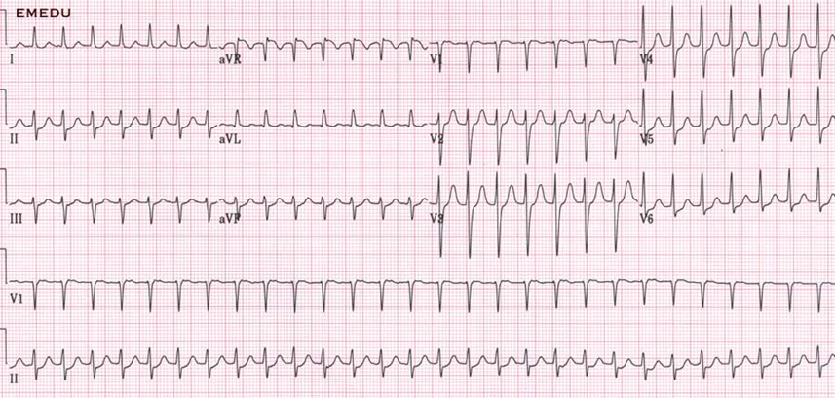
Difference between Fast AF and SVT
RR Interval
Variable in Fast AF
Regular in SVT
Fast AF
(Irregular)
SVT
Regular

